Slide 1
shutter speed

Slide 2
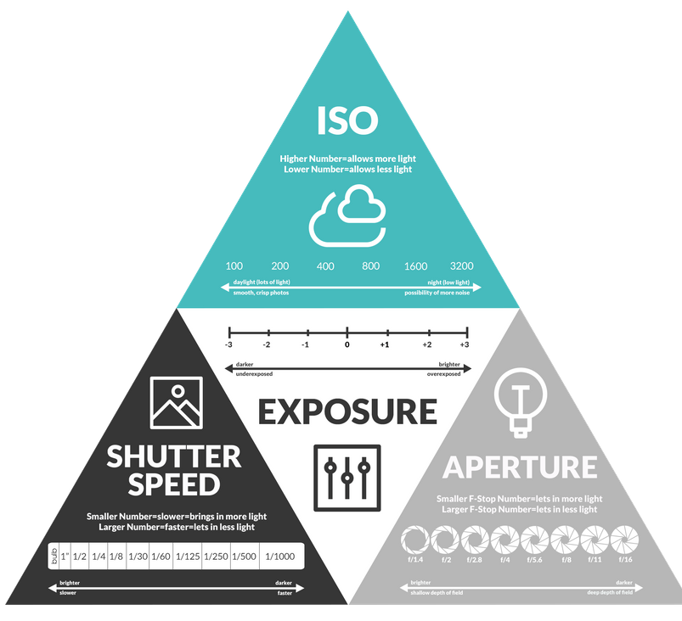
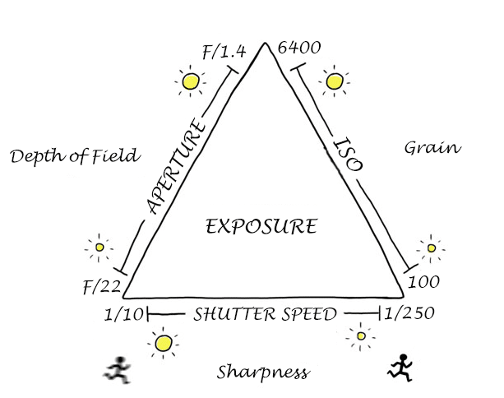
how does this link to photography?

Slide 3
what is shutter speed?

Slide 4
Shutter speed is the amount of time that the camera shutter is open
A camera shutter is a curtain in front of the camera sensor.
When you take a photo, the shutter opens and closes, letting in a certain amount of light depending on the camera settings.

Slide 5
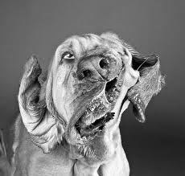
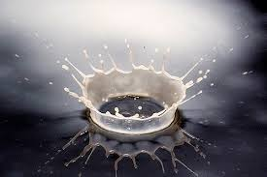
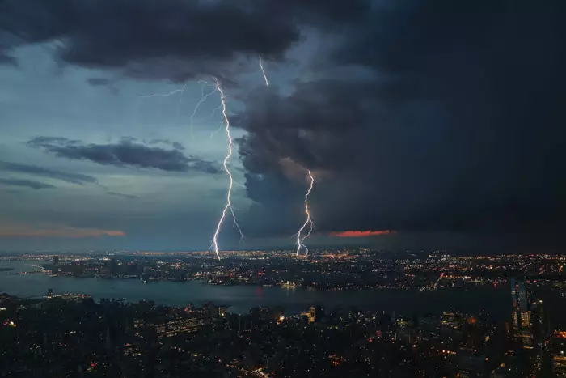
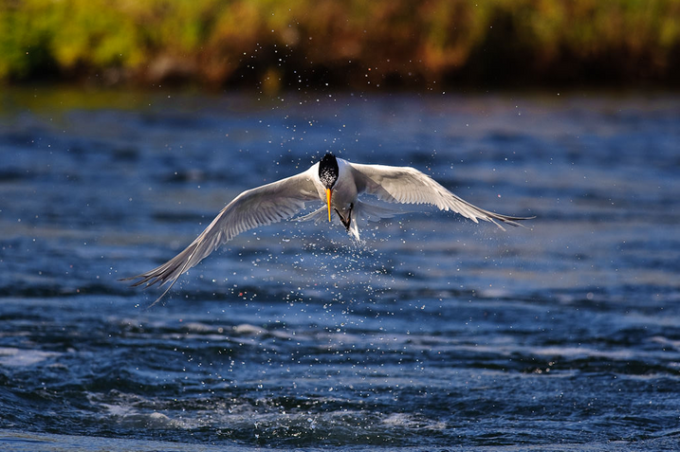
Fast shutter speeds will freeze the action
Sports
Wild life
Action
Motion
Movement

Slide 6
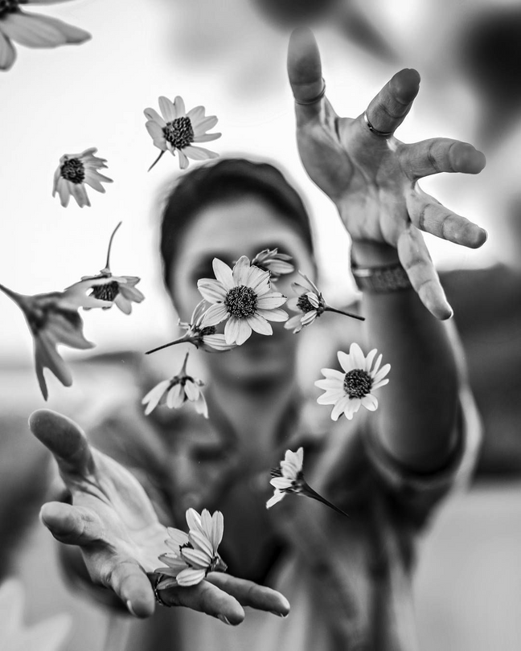
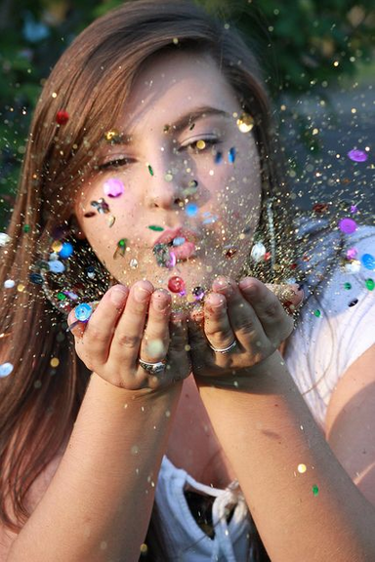
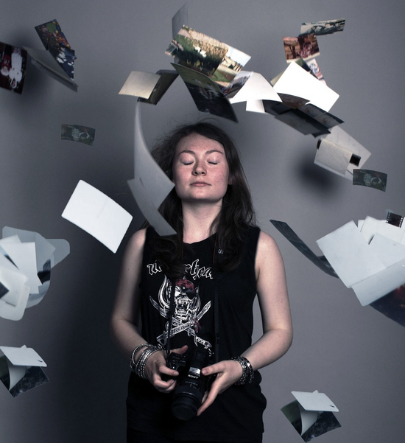
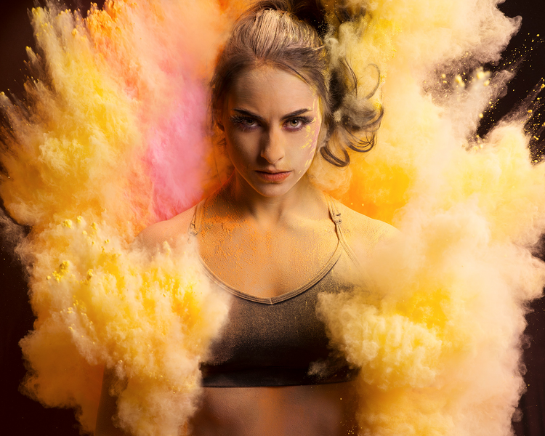
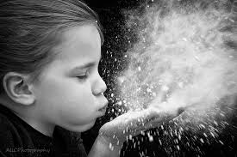
Fast shutter speeds will freeze the action
Portrait
How do you think these were created?

Slide 7
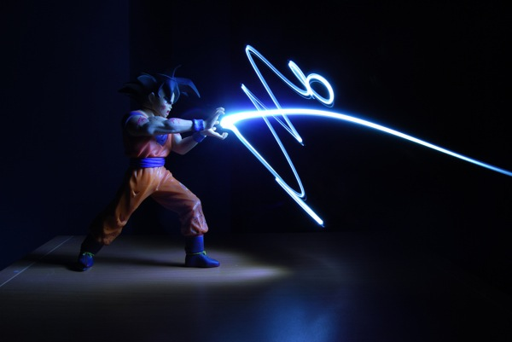
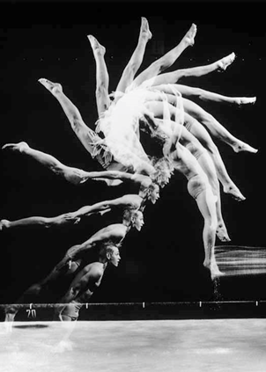
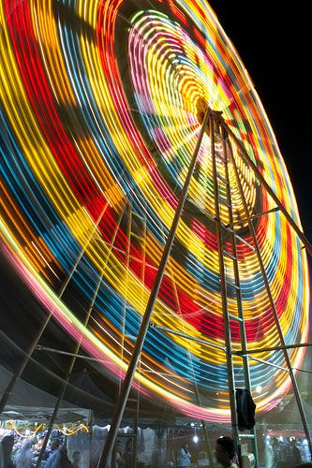
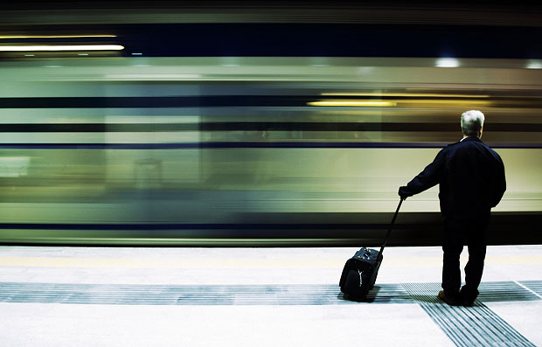
Slow shutter speeds will blur the action
Using a strobe light in a studio set-up to capture multiple images simultaneously.

Slide 8
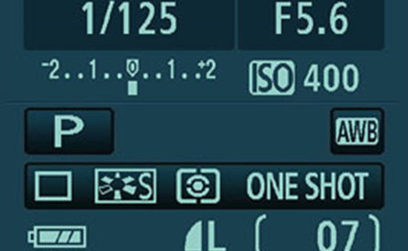
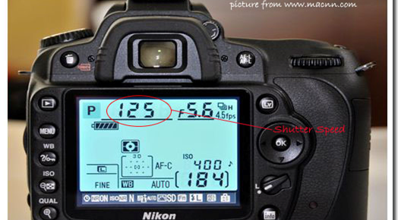
Shutter speed is measured in fractions of seconds.
The bigger the denominator, the faster the speed
e.g 1/1000 is much faster than 1/30.
One thousandth of a second.
Freeze frame
Lower than 1/60 a tripod is needed to eliminate hand shake
Half a second.
lots of blur
" - means whole seconds

Slide 9
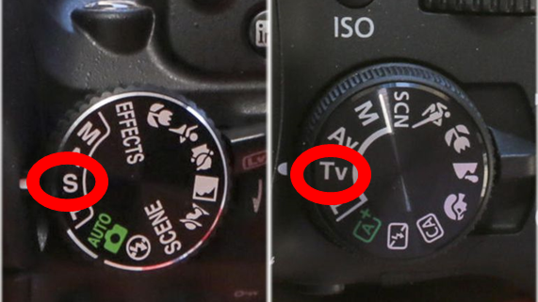
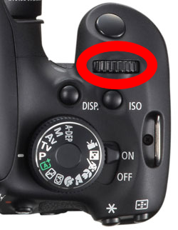
Put your camera in 'Shutter priority'
Practise changing the shutter settings. What is your cameras range?
Turn dial to adjust shutter speed
Other
Canon

Slide 10
Movement
Action
Motion
To practise changing shutter speed settings
A photo shoot showing a range of shutter speeds
Explained what 'shutter priority' is.
Diagram showing different shutter speeds
Photo shoot that demonstrates slow and fast shutter speeds
Added notes to show what settings were used for each image
Annotation for best and worst photos
Different people moving at different speeds at the same time, jumping, star jumps, spinning.
A crowd of people (Set up your camera on a stable surface or use a tripod at lesson change over)
Pouring water, object splashing in water, objects falling over, leaves thrown up in air,
Upload your photoshoot to folder 'shutter speed photo shoot'
PPT is easier for presenting final images
Images should be jpeg or png format
Upload final PPT to Onenote
Further explained why you need to use different shutter speeds
Explored 'panning' technique
Researched 'Light photography'

